Slide 1
Vocabulary
Unit 14
Level E

Slide 2
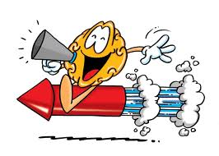
alacrity
(n.) a cheerful readiness; brisk and eager action
Synonyms: promptness, willingness, dispatch, celerity
Antonyms: reluctance, unwillingness, hesitancy

Slide 3
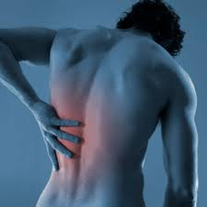
alleviate
(v.) to relieve, make more bearable
Synonyms: lesson, lighten, allay, mitigate, assuage

Slide 4
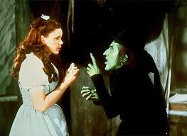
antithesis
(n.) the direct opposite, a sharp contrast
Synonyms: contrary, antipode

Slide 5
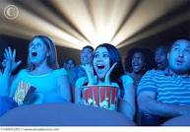
appall
(v.) to fill with dismay or horror
Synonym: shock, stun, stupefy, horrify
Antonyms: please, cheer, gladden, elate, exhilarate

Slide 6
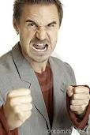
bellicose
(adj.) warlike in manner or temperament; quarrelsome
Synonyms: aggressive, combative, belligerent
Antonyms: amicable, peaceable, concillatory, pacific

Slide 7
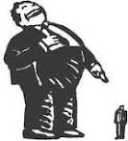
disparage
(v.) to belittle, speak slightingly of; to undervalue
Synonyms: degrade, decry, run down, underrate
Antonyms: praise, extol, laud, plug

Slide 8
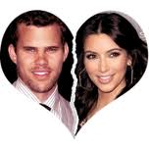
dissonant
(adj.) not in harmony; disagreeing, at odds
Synonyms: grating, strident, unmelodious, irreconcilable
Antonyms: harmonious, agreeing, euphonious

Slide 9
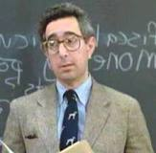
droll
(adj.) amusingly odd
Synonyms: comical, humorous, whimsical, zany
Antonyms: humorless, solemn, dour

Slide 10
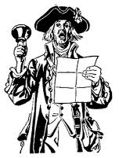
edict
(n.) an order issued by someone in authority
Synonyms: command, decree, proclamation

Slide 11
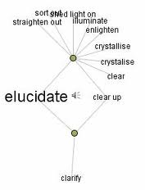
elucidate
(v.) to clarify, explain
Synonyms: interpret, expound, explicate
Antonyms: obscure, becloud, muddy, obfuscate

Slide 12
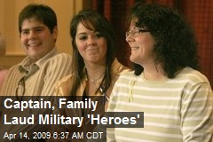
laud
(v.) to praise
Synonyms: hail, extol, glorify, exalt
Antonyms: criticize, censure, belittle, disparage

Slide 13
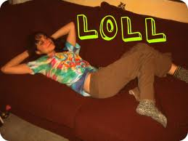
loll
(v.) to act in a lazy manner; to lounge; to recline, droop
Synonyms: loaf, loiter, sag, dangle

Slide 14
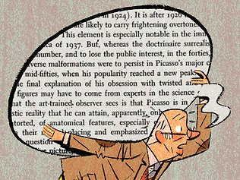
loquacious
(adj.) talkative, wordy; fond of talking
Synonyms: gossipy, voluble, garrulous, long-winded
Antonyms: silent, reticent, closemouthed, terse, taciturn

Slide 15
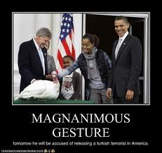
magnanimous
(adj.) generous in forgiving, above small meanness
Synonyms: unselfish, charitable, noble, bighearted
Antonyms: petty, selfish, unforgiving, spiteful

Slide 16
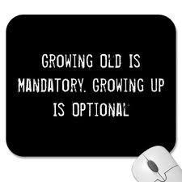
mandatory
(adj.) required, obligatory
Synonyms: compulsory, requisite, imperative
Antonyms: optional, not outstanding; not easily classified

Slide 17
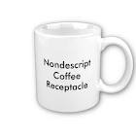
nondescript
(adj.) ordinary, not outstanding, not easily classified
Synonyms: plain, unremarkable, unimpressive
Antonyms: distinctive, remarkable, vivid, prepossessing

Slide 18
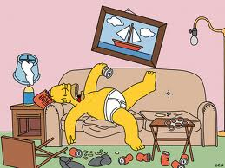
phlegmatic
Synonyms: lethargic, indolent, torpid, stolid, impassive
Antonyms: emotional, sensitive, thin-skinned, excitable
(adj.) slow-moving, sluggish, unemotional

Slide 19
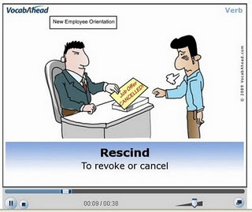
rescind
(v.) to repeal, cancel
Synonyms: withdraw, revoke, retract, annul, abrogate
Antonyms: affirm, endorse, uphold, ratify

Slide 20
vivacious
(adj.) lively, sprightly, full of energy
Synonyms: spirited, animated, ebullient
Antonyms: dull, spiritless, listless, indolent, languid

Slide 21
whet
(v.) to sharpen, put an edge on; to make keen or eager
Synonyms: hone, excite, stimulate
Antonyms: dull, blunt, deaden, stifle, dampen

