Slide 1
Vocabulary
VOCABULARY
Quiz 100%
Level G Unit 2

Slide 2
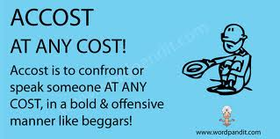
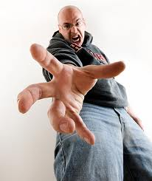
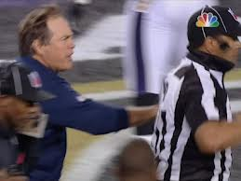
accost
(verb) to approach and
speak to first; to
confront in a
challenging or
aggressive way
SYN: buttonhole,
approach, confront
ANT: evade, avoid, shun

Slide 3
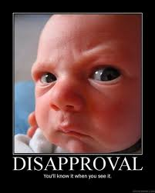
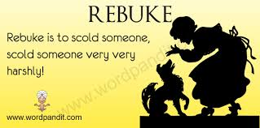
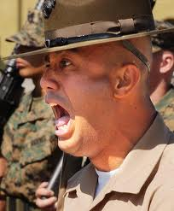
animadversion
(noun) a comment
indicating strong
criticism or
disapproval
SYN: rebuke, reproof
ANT: praise,
compliment

Slide 4
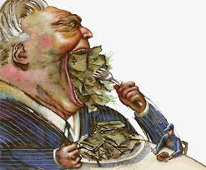
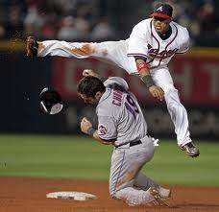
avid
(adjective) desirous of
something to the
point of greed;
intensely eager
SYN: keen,
enthusiastic, grasping
ANT: reluctant,
indifferent,
unenthusiastic

Slide 5
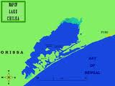
brackish
(adjective) having a
salty taste and
unpleasant to
drink
SYN: briny, saline
ANT: fresh, clear,
sweet

Slide 6
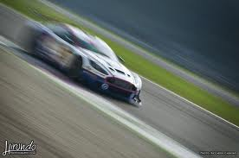
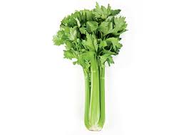
celerity
(noun) swiftness,
rapidity of motion
or action
SYN: promptness,
alacrity, speed
ANT: slowness,
sluggishness,
dilatoriness

Slide 7
devious
(adjective) straying or
wandering from a
straight or direct course;
done or acting in a shifty
or underhanded way
SYN: roundabout, indirect,
tricky, sly, artful
ANT: direct,
straightforward, open,
aboveboard

Slide 8
gambit
(noun) in chess, an
opening move that
involves risk or
sacrifice of a minor
piece on order to gain
a later advantage; any
opening move of this
type
SYN: ploy, stratagem,
ruse, maneuver

Slide 9
halcyon
(noun) a legendary bird
identified with the
kingfisher; (adjective) of
or relating to the halcyon;
calm, peaceful; happy,
golden; prosperous,
affluent
SYN: (adjective) tranquil,
serene, placid, palmy
ANT: (adjective) turbulent,
chaotic, tumultuous

Slide 10
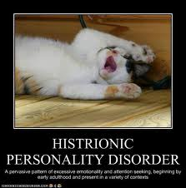
histrionic
(adjective) pertaining
to actors and their
techniques; theatrical,
artificial;
melodramatic
SYM: affected, stagy
ANT: low-keyed, muted,
untheatrical, subdued

Slide 11
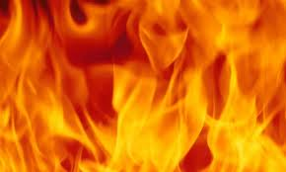
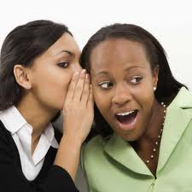
incendiary
(adjective) deliberately setting
or causing fires; designed to
start fires; tending to stir up
strife or rebellion; (noun)
one who deliberately sets
fires, arsonist; one who
causes strife
SYN: (adjective) inflammatory,
provocative; (noun) firebrand
ANT: (adjective) soothing,
quieting; (noun) peacemaker

Slide 12
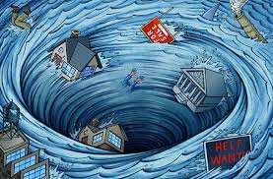
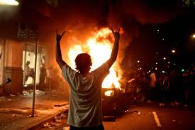
maelstrom
(noun) a whirlpool of
great size and
violence; a
situation resembling
a whirlpool in
violence and
destruction
SYN: vortex, chaos,
turbulence, tumult

Slide 13
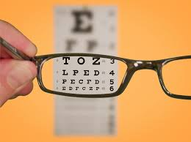
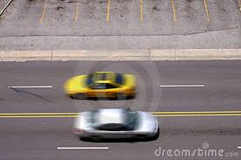
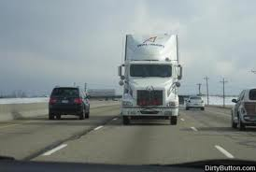
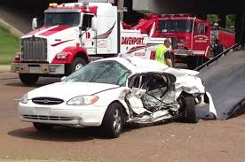
myopic
(adjective)
nearsighted;
lacking a broad,
realistic view of a
situation; lacking
foresight or
discernment
SYN: shortsighted
ANT: farsighted

Slide 14
overt
(adjective) open, not
hidden, expressed or
revealed in a way that
is easily recognized
SYN: clear, obvious,
manifest, patent
ANT: secret, clandestine,
covert, concealed

Slide 15
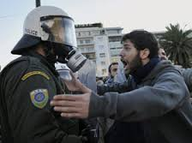
pejorative
(adjective) tending to
make worse;
expressing
disapproval or
disparagement,
derogatory,
deprecatory, belittling
ANT: complimentary,
ameliorative

Slide 16
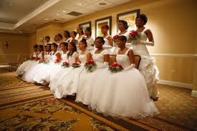
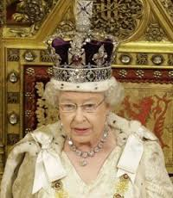
propriety
(noun) the state of being
proper,
appropriateness; (plural)
standards of what is
proper or socially
acceptable
SYN: fitness, correctness,
decorum
ANT: unseemliness,
inappropriateness

Slide 17
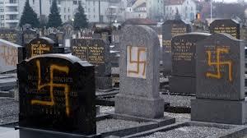
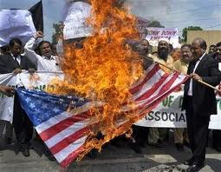
sacrilege
(noun) improper or
disrespectful
treatment of
something held
sacred
SYN: desecration,
profanation,
defilement

Slide 18
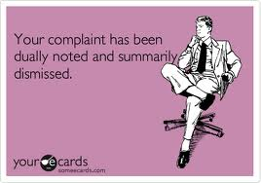
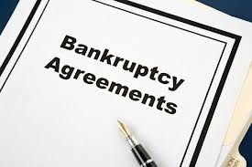
summarily
(adverb) without
delay or formality;
briefly, concisely
SYN: promptly,
peremptorily,
abruptly

Slide 19
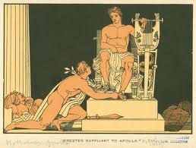
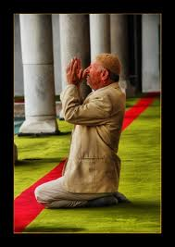
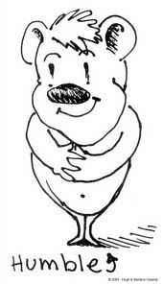
suppliant
(adjective) asking
humbly and
earnestly; (noun)
one who makes a
request humbly
and earnestly, a
petitioner, suitor

Slide 20
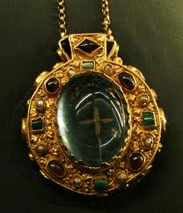
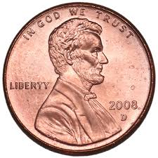
talisman
(noun) an object
that serves as a
charm or is
believed to
confer magical
powers, an
amulet, fetish

Slide 21
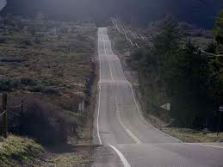
undulate
(verb) to move in
waves or with a
wavelike motion;
to have a wavelike
appearance or form
SYN: ripple, fluctuate,
rise and fall

